Slide 1
Board of Regents
2024 Post-Session Legislative Update
Clayton Abbey
March 11, 2024
Office of Government &
Community Relations

Slide 2
2024 Post-Session Report
On Wednesday, March 6, 2024, the Governor’s signing period to act on legislation from the 2024 Session ended.
The Governor signed 69 bills including, most crucially, a $10.19 billion budget bill and two capital outlay bills.
Major legislation creating a Higher Education Trust Fund and establishing Affirmative Consent rules will impact New Mexico State University. Additionally, there will be changes to the Lottery and Opportunity Scholarship that provide more flexibility to students.

Slide 3
Statewide Higher Education Support
Passage of Senate Bill 159, creating the Higher Education Trust Fund. The Trust Fund will receive a $959 million transfer. $10.6 million is earmarked for shortfalls in FY 24 Opportunity Scholarship funding.
$23.8 million in instruction and general funding to all higher education institutions, an increase of 3% from the previous fiscal year. This increase includes earmarks for targeted faculty compensation ($7M), student support services ($3M), and support for graduate assistants ($1.9M).
$33 million in funding to provide a 3% across-the-board compensation increase to all non-probationary employees. Additional funding of $9.4 million will be distributed to institutions as a partial offset to insurance premium increases.
$32.5 million for Building Renewal and Replacement and Demolition
$5 million for Equipment Renewal and Replacement
$5.5 million to K-12 and higher education institutions for cybersecurity
$1 million for Dual Credit programs at higher education institutions
$10 million for graduate scholarships to New Mexico graduates in STEM programs
$10 million for social work endowed faculty positions, financial aid and paid practicums
$10 million in new funding and a $15 million authorization from the Technology Enhancement Fund to support research institutions in match requirements
$60 million in workforce training tuition coverage to be spent over three fiscal years
$6 million in funding for Integrated Basic Education and Skills Training programs to be spent over three fiscal years

Slide 4
New Mexico State University System-Specific Support
$10.8 million in increased instruction and general funding, targeted faculty compensation, wrap-around service funding, and support for Research and Public Service Projects
$18 million in one-time funding including support for Global Campus ($6.5M), the Creative Media Institute ($4M), Athletics ($1M), the College of Engineering’s Manufacturing Sector Development Program, and the Department of Agriculture.
$6.8 million in earmarked funding through the Government Responsibility and Opportunity Fund, to be spent over two fiscal years.
$ 90 million in funding for capital outlay projects

Slide 5
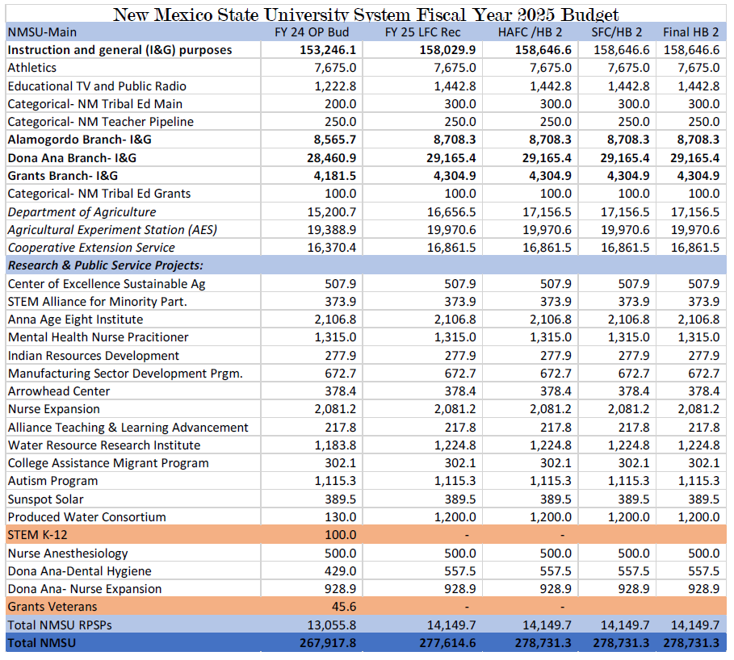
New Mexico State University System Instruction and General & Research and Public Service Project Funding (House Bill 2)
All amounts in thousands

Slide 6
New Mexico State University System Special Appropriation Funding (House Bill 2)
All amounts in thousands

Slide 7
Government Results and Opportunity (GRO) Funding
All amounts in thousands

Slide 8
Capital Outlay Funding – Senate Bill 275
All funding in thousands

Slide 9
Capital Outlay – House Bill 308 General Obligation Bond Funding
*Funding contingent upon voter approval of the funding in the November 2024 General Election
** Governor Michelle Lujan Grisham vetoed the words “creative media” in the $10M appropriation

Slide 10
Upcoming Legislative Retirements and Transitions
Senate | House
Bill Burt (Alamogordo/ Senate Finance) | Anthony Allison (Fruitland/House Appropriations)
Bill Tallman (Albuquerque) | Gail Chasey (Albuquerque/House Majority Leader)
Brenda McKenna (Albuquerque) | James Townsend (Artesia/Expected to run for Senate)
Cliff Pirtle (Roswell) | Larry Scott (Hobbs/Expected to run for Senate)
Gerald Ortiz y Pino (Albuquerque) | Rod Montoya (Farmington/Expected to run for Senate)
Gregg Schmedes (Placitas)
Mark Moores (Albuquerque)
Nancy Rodriguez (Santa Fe/Senate Finance )
Ron Griggs (Alamogordo)
Steve Neville (Farmington)

